Slide 1
Hops: Fine-grained heterogeneous sensing, efficient and fair Deep Learning cluster scheduling system
Qinghe Wang (School of Artificial Intelligence, Anhui University)
Futian Wang (Anhui University)
Xinwei Zheng (Institute of Artificial Intelligence, Hefei Comprehensive National Science Center)
Notes:
Hello everyone, I am Wang Qinghe from Anhui University. Today, I will be presenting my paper : "Hops: Fine-grained Heterogeneous Sensing, Efficient and Fair Deep Learning Cluster Scheduling System." This paper is a collaborative work with my mentors, Wang Futian and Zheng Xinwei.

Slide 2
Overview
Introduction
concepts
challenges
Design
System architecture
Multi-layer database
profiler
scheduler
Experiments
Notes:
This is the outline of my presentation. I will cover three main aspects: Introduction, Design, and Experiments[ɪk'sperɪ.ment].

Slide 3
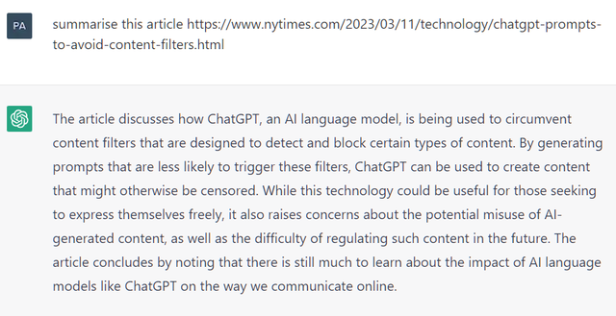

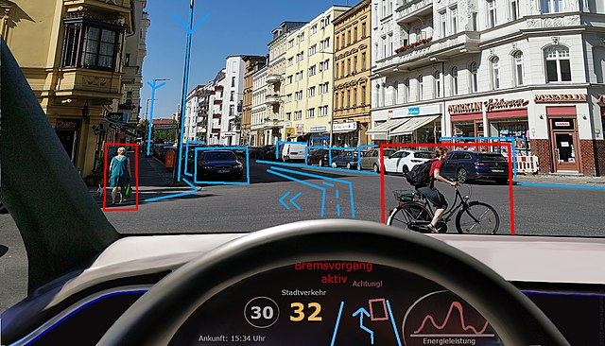
The development of deep learning
ChatGPT
Face recognition
Autonomous driving
The surge in deep learning (DL) tasks, with their heavy hardware requirements (GPUs and CPUs) , has led to the rise of clusters and cloud platforms tailored for deep learning acceleration
Notes:
With the development of artificial intelligence, the number of deep learning tasks is increasing rapidly, such as ChatGPT, facial recognition, and autonomous driving. These tasks often require heavy hardware resources, leading to a increase in clusters and cloud platforms tailored/ˈteɪ.lərd/ for deep learning.

Slide 4
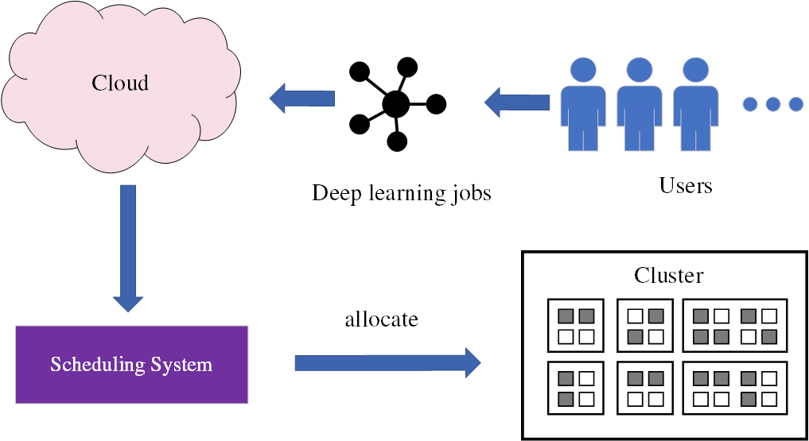
Deep learning (DL) cluster scheduling system
The scheduling system decides how to allocate resources to jobs in order to minimize the training time, maximize cluster utilization, or ensure fairness.
Notes:
Users typically submit their deep learning jobs to the cloud platform, and the scheduling system decides how to allocate resources to jobs in order to minimize the training time, maximize cluster utilization, or ensure fairness.

Slide 5
What does a DL cluster scheduling system usually contain?
Profiler
The DL jobs usually exbihit some characteristics
Perceiving job performance can guide the scheduler to make wiser decisions
Profiling at runtime can correct some erroneous decisions made by the scheduler
For example
Gandiva uses a profiler to measure the memory footprint of DL jobs to support job packing
Gavel and Sia use a profiler to measure job throughput
Pollux uses a profiler to measure the statistical efficiency of DL jobs
Notes:
So, what does a DL cluster scheduling system usually contain?
First, a profiler is usually essential, as deep learning jobs often exhibit certain characteristics. The profiler can estimate and perceive job performance, guiding the scheduler to make wiser decisions. Profiling at runtime can also correct some erroneous decisions made by the scheduler.
Here are some examples of previous SOAT/soʊt/ schedulers.

Slide 6
What does a DL cluster scheduling system usually contain?
Scheduling algorithm
Heuristic: Greedy algorithms, Genetic algorithms, ...
Planning algorithms: LP function or ILP function
Deep learning methods: reinforcement learning
Waiting queue
Usually need a queuing strategy to decide the priority of waiting jobs
The queuing strategy reflects the fairness that cluster managers care about
Classical queuing strategy: FIFO, LAS, SJF, SRTF
Notes:
Typically, the system also requires a scheduling algorithm to allocate resources. Scheduling algorithms can generally be classified into heuristic[hjuˈrɪstɪk]-based algorithms, planning algorithms, and deep learning-based algorithms.
In addition, a waiting queue are also a common component. The waiting queue typically requires a queuing strategy to determine the priority of each job, and this strategy usually reflects the fairness that cluster managers care about.

Slide 7
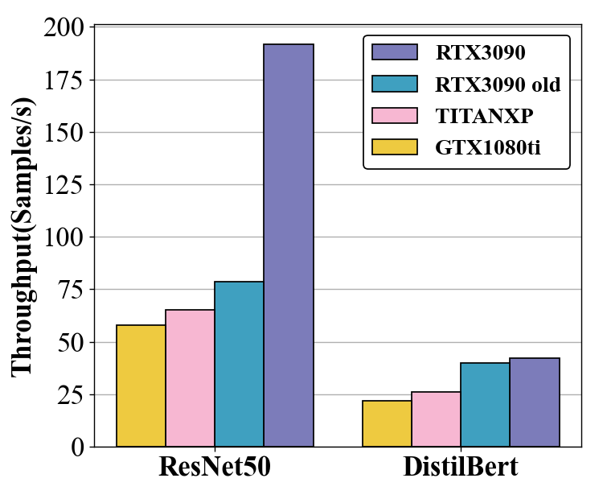
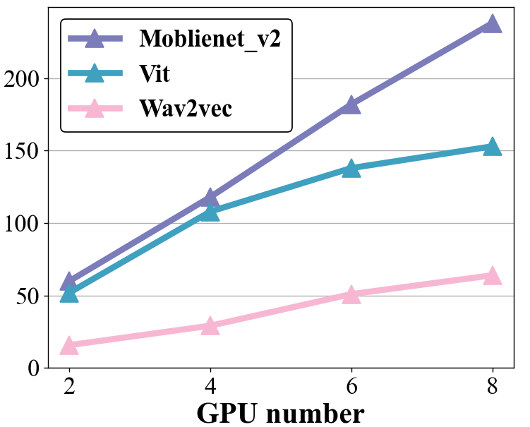
Challenge 1: How to design a profiler with low overhead and high accuracy?
Heterogeneity of resources
The evolution of GPUs and CPUs and servers
Different location in the network
Heterogeneity of DL jobs
Some DL jobs exhibit nonlinear speedup ratios
These factors result in difficulties in throughput estimation
Notes:
However, there are still some challenges in current deep learning scheduling systems. First, designing a profiler with both low overhead and high accuracy is a challenge. This is due to the heterogeneity [ˌhetəroʊdʒəˈniɪti] of resources; for example, hardware resources like GPUs and CPUs evolve rapidly, and each server may be located in different positions within the network.
In the left diagram, you can see that the throughput of two neural network tasks varies significantly across different resources. Additionally, deep learning jobs themselves also exhibit heterogeneity[ˌhetəroʊdʒəˈniɪti]. In the right diagram, it is evident that as the number of GPUs increases, some deep learning jobs show a nonlinear growth trend.

Slide 8
Challenge 2: How to design a scheduler with both efficiency and fairness?
Both efficiency and fairness are important factors
Efficiency decides how fast a job can run in the cluster
Ensuring fairness guarantees the user experience
Many schedulers can’t balance well between efficiency and fairenss
Gandiva and Tiresias optimize makespan and average JCT (Job Completion Time)
do not consider fairness.
Sia and Pollux focus on improving the throughput of DL jobs, easy to favor high-throughput DL jobs
Provides a knob to increase the power of the respective operations to have equal access to resources by reducing throughput rates
hard to meet the queuing logic
Notes:
Challenge 2: How to design a scheduler with both efficiency and fairness?
Efficiency determines how fast jobs can run in the cluster, while fairness ensures a positive user experience; both are crucial. However, many schedulers can’t balance well between efficiency and fairenss
For example, previous schedulers like Gandiva, and Tiresias do not take fairness into account. On the other hand, Sia and Pollux tend to favor high-throughput jobs. Though they provide a knob to adjust fairness, allowing the reduction of throughput to increase the equal access to resources of each job, this approach still fails to satisfy the queuing logic and thus does not guarantee the fairness that the cluster cares about

Slide 9
Challenge 3: How to reduce starvation brought by classical queuing strategy?
Classical queuing strategies
Least-Attained Service (LAS)
Shortest-job-first (SJF)
Shortest-remaining-time-first (SRTF)
Observation of the existing queuing strategies
minimize the average JCT of DL jobs
overly favor short jobs, leading to starvation for relatively longer jobs
Existing solutions
A threshold to determine if a job is starving, elevating its priority if it is. But shorter jobs usually have stricter latency requirements.
Absolute fairness like time-slicing, FIFO. Can’t guarantee the user experience for short-term users
Notes:
Challenge 3: How to reduce starvation brought by classical queuing strategies?
We have found that many classical queuing strategies, such as LAS, SJF, and SRTF, are often proposed to reduce average [ævərɪdʒ] job Completion time. However, their strong bias towards short jobs can lead to starvation for relatively longer jobs.
To address starvation, some solutions already exist, such as setting a threshold [θreʃ (h)əʊld] to increase the priority of starving jobs. However, shorter jobs typically have stricter latency requirements, making a one-size-fits-all threshold is hard to ensuring a positive user experience.
Additionally, absolute fairness strategies, like time slicing and first-in-first-out, can’t guarantee the user experience for short-term users.

Slide 10
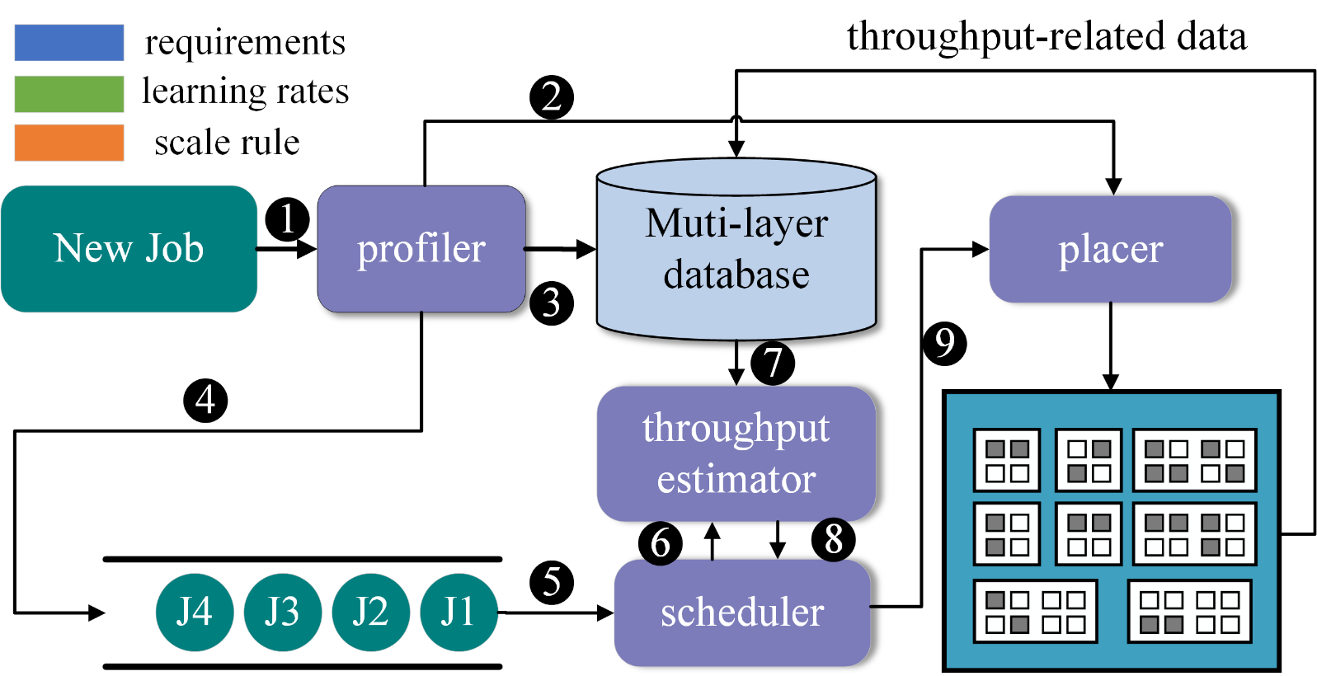
Hops: System architecture
Round-based
ILP algorithm
Dynamics
Notes:
Next, I will introduce the design of Hops. First, here is the system architecture. Hops first runs incoming jobs on various types of GPUs, and then writes some data into a multi-layer database. After that, the jobs are placed in the waiting queue. Our scheduler performs round-based scheduling, estimating the throughput of each task based on the data from the database under various configurations.
Internally, the scheduler uses an ILP algorithm to solve the optimal placement within each round. The resulting plan is executed by the Placer. Hops is dynamic; when jobs or workloads change, the updated data will be stored in the database, and the throughput estimator will use this updated data for its estimation.

Slide 11
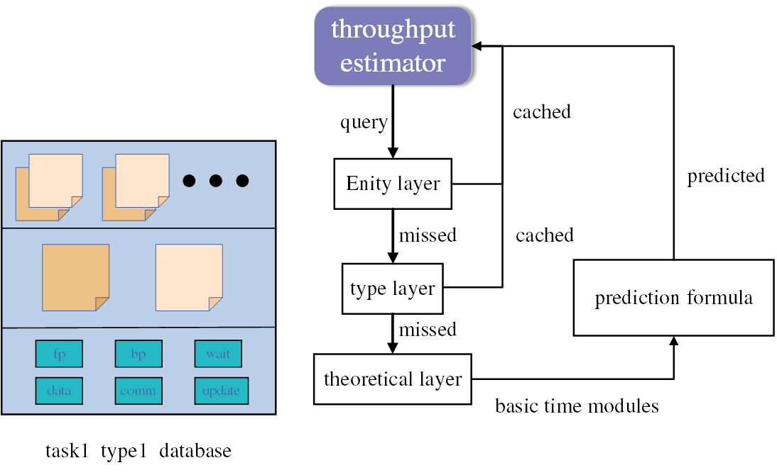
Hops: Throughput Estimator
First query the top two layer of database
If missed, use prediction formula to estimate
Historical Data Estimation + Formula Prediction
As the history data accumulates,
the granularity of heterogeneous sensing can reach the server entity level
history throughput
Basic time modules
Notes:
Hops utilizes two methods to achieve high-accuracy throughput estimation: historical data and Formula Prediction. We designed a multi-layered database where an instance is created for each combination of job and GPU type. The first layer is server entity layer, records the throughput data of jobs on different server entities. The second layer is GPU type layer, stores throughput data for jobs running on specific GPU types. The bottom layer holds basic time modules for deep learning jobs.
The throughput estimator follows a “top-down” access method, first access data from the entity layer. If that is a miss, it will then access historical data from the GPU type layer. If that is also a miss, it will finally access the theoretical layer to obtain basic time modules, which will then be used in the throughput prediction formula for estimation.
As the history data accumulates,
the granularity /ˌɡrænjʊˈlærəti/ of heterogeneous sensing can reach the server entity level

Slide 12
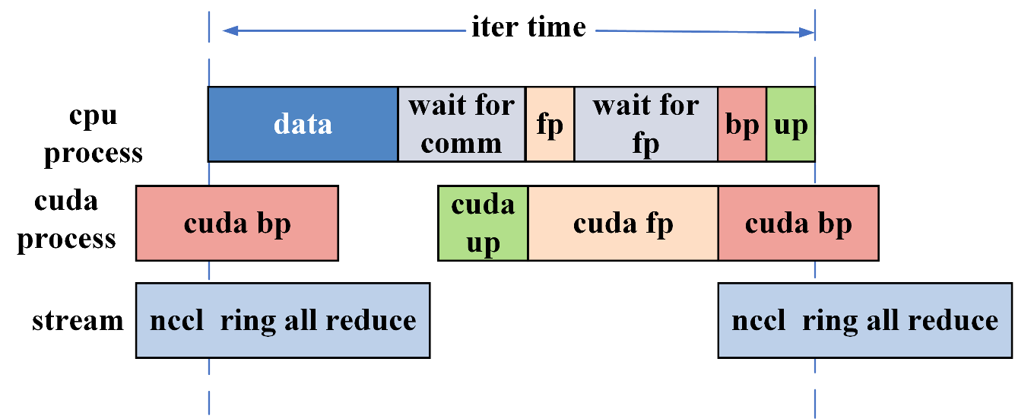
Hops: Throughput Estimator-prediction formula
Most DL jobs use synchronous data parallelism (DP) as a training method
This training method has some special characteristics in common
Iteration time breakdown
One iteration consists of several basic time modules
CPU process and CDUA process and communication stream can overlap
Every iteration contains two synchronization points
Communication time is proportional to the model’s parameter size
Notes:
Next, we will introduce the throughput estimation formula in Hops. Most jobs use synchronous data parallelism, so this paper studies the job trained in this manner and find several characteristics:
For instance, the training time for one iteration typically includes several basic time modules: data loading, forward propagation, backward propagation, and waiting for synchronization and so on. As shown in the diagram, three processes can execute simultaneously, often overlapping with each other. Additionally, there are two synchronization points within one iteration, indicated by the gray blocks in the diagram. Furthermore, communication time is proportional to the amount of model parameters.

Slide 13
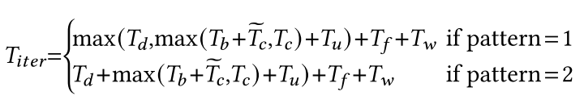
Hops: Throughput Estimator-prediction formula
Low overhead (Only need to run 10~50 iterations on each type of GPU)
High accuracy (adapt to changes in the number of GPUs)
forward propagation time, backward propagation time are stable, only need to test several iterations on each type of GPU
Some basic time modules like dataloading time may fluctuate, we model them as a probabilistic formula and keep tracking in subsequent runs
Communication time changes with number of GPUs and servers, we use all reduce formula
Notes:
We designed the throughput estimation formula based on the characteristics of deep learning jobs during data parallelism. The execution time for one iteration of a job can be represented by these basic time modules. Some modules, such as forward and backward propagation time, tend to be relatively stable, allowing us to test several iterations on each type of GPU.
Other modules, such as data loading, may fluctuate/ˈflʌktʃueɪt/ , so we model them as a probabilistic formula and continuously track them in subsequent iterations. Communication time varies with the number of GPUs, and we model this using the all-reduce formula. The formulas for each module can be found in the paper. By utilizing these prediction formulas, we can achieve low overhead and high accuracy in throughput estimation.

Slide 14
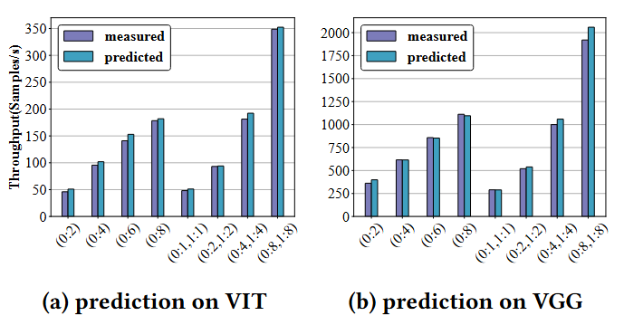
Evaluation: Prediction Accuracy
High prediction accuracy on DL jobs
Low overhead: the average profiling cost is at the minute level
Notes:
We conducted accuracy tests and found that Hops shows high prediction accuracy under various configurations. Additionally, the average profiling cost is at the minute level.

Slide 15
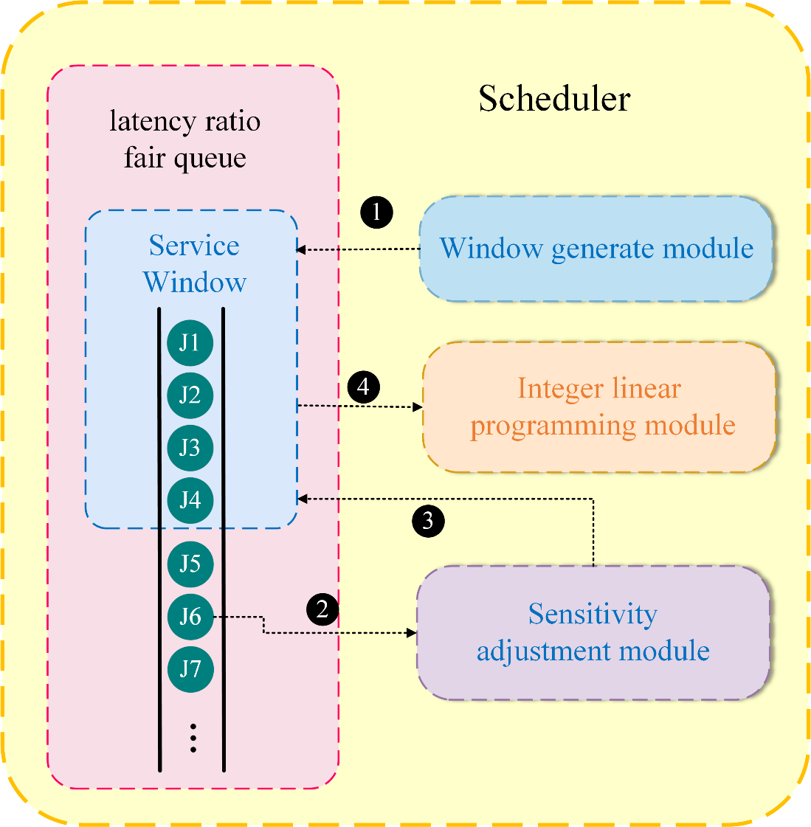
Hops: Scheduler
Latency ratio fairness
Service window
ILP formula
Sensitivity adjustment
Notes:
Next, we will discuss the specific design of the scheduler in Hops. We proposed a new fairness metric called latency ratio fairness and maintain a fairness queue. Additionally, our scheduler operates on a round-based scheduling mechanism. In each round, a service window is created at the head of the queue, and only the jobs within this window can be scheduled during ILP planning for scheduling.
Moreover, we have implemented a sensitivity adjustment mechanism. Next, I will introduce the function of each module.

Slide 16

Hops: Scheduler-latency ratio fairness
The latency ratio is the ratio of a job’s waiting latency to its own age
We introduce the "Latency Ratio Fairness" (LRF)
In the process of cluster scheduling, the latency ratio for each job should be kept as low as possible and should tend to be similar across jobs
Reflects the system does not excessively favor either short or long jobs
the measured waiting time of the job in the system
the expected running time of the job without waiting in the cluster
Notes:
In our discussions with cluster users, we found that job waiting latency plays a significant role in user experience. However, jobs of different lengths have varying tolerances for starvation; shorter jobs typically have a lower tolerance. The question is, how can we ensure that jobs of different lengths do not experience starvation?
To address this, we designed a metric called the latency ratio, which is the ratio of a job's waiting time to its own age. Wait i is the the measured waiting time of the job in the system. The age i is the expected running time of the job without waiting in the cluster. By using this formula, we can quantify the level of starvation, allowing us to compare the starvation levels of different lengths jobs.
We further introduced a principle of fair sharing among users in the cluster, it is called Latency Ratio Fairness (LRF). During the scheduling process, the goal is to keep the latency ratio of each job as low as possible while ensuring that these ratios tend to be similar among jobs. This reflects the system does not excessively favor either short or long jobs.

Slide 17
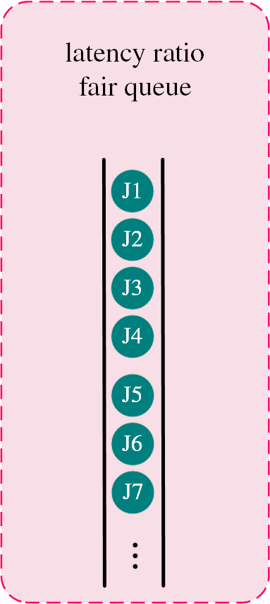

Hops: Scheduler-latency ratio fairness queue
We designed a latency ratio fairness priority and sorts the queues in descending order
Hops continuously updates the waiting time of each job in the queue and adjusts the queue order
The age of the job can be estimated based on the estimated running speed and its total iteration number
Notes:
Thus, to satisfy LRF. We designed a latency ratio fairness priority and sorts the queues in descending order. Hops continuously updates the wait time of each job in the queue and adjusts the queue order.

Slide 18
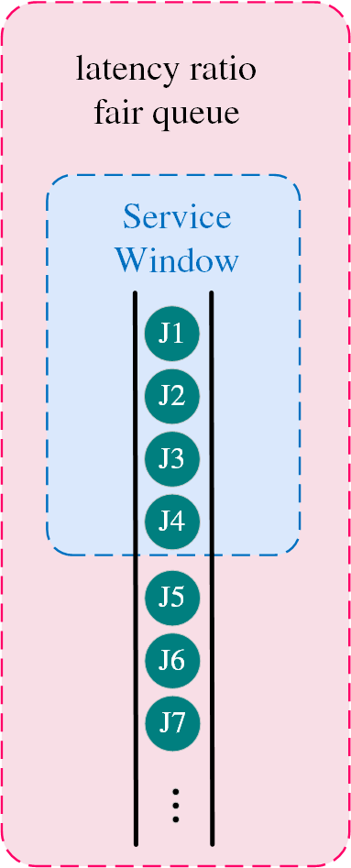
Hops: Scheduler-service window
Considering the entire queue will increase the search space and violate fairness
Increase the search space: the cluster has limited number of GPU cards, but the total demand for jobs in the queue is greater
Violate fairness: high-throughput jobs may have a greater chance of being scheduled regardless of queue order
Size of service window matches cluster size
Only tasks in the window have a chance to be scheduled in current round
Some starved jobs will enter the window in future rounds due to their increasing priorities
Notes:
The processing capacity of the cluster is limited, so it is unnecessary to consider scheduling for all jobs. Scheduling high-throughput jobs located at the end of the queue may also violate the principle of fairness. To address this, we created a window that matchs to the cluster size, allowing only the jobs within this window to be scheduled.

Slide 19
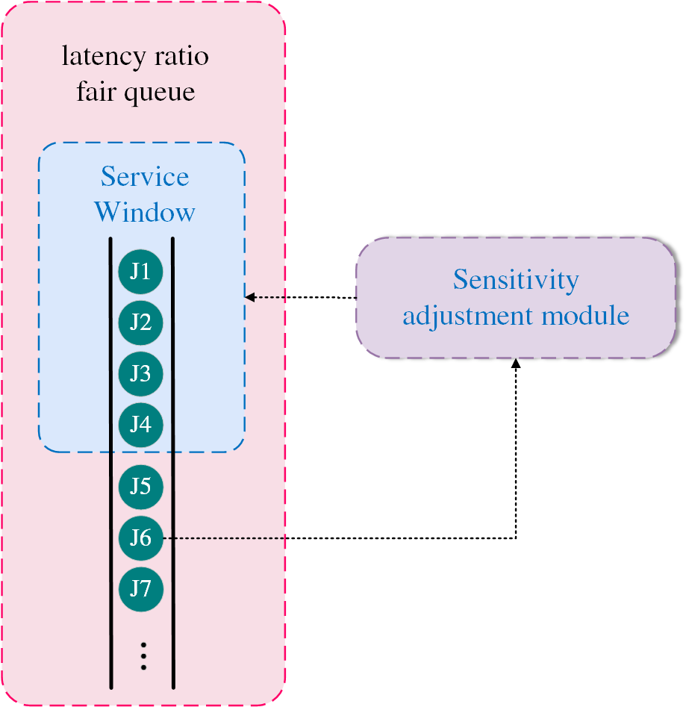
Hops: Scheduler-Sensitivity adjustment
There are still resource fragments left after the first scheduling
Plans multiple times within a round.
Move jobs that are less sensitive to distributed placement into the window to fill the resource fragments
Notes:
We designed a sensitivity adjustment mechanism that allows for multiple scheduling iterations within a single round, as long as there are free GPUs available in the cluster.
When planning for cluster fragmentation, we moves jobs that are less sensitive to distributed placement into the window to fill the resource fragments .

Slide 20
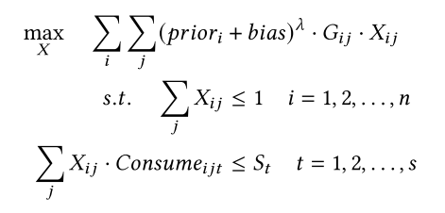
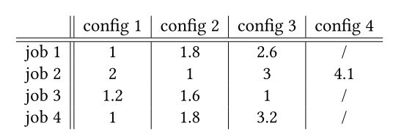
Hops: Scheduler-Prior weighted ILP formula
Throughput gain matrix G
Prior weighted:
for high-priority jobs, weight acts as a reward
for low-priority jobs, weight acts as a punishment
the degree of punishment and reward is directly proportional to the priority
A good balance between efficiency and fairness
Support for other types of priority
Notes:
We designed an ILP formulation with priority weights. First, we pre-generated several configurations for a job and calculated the throughput for each configuration. This data was then normalized, shown in the throughput gain matrix G. We used a selection matrix X to represent the choice of a configuration. This approach is similar to that of Sia, but we added job priority as weights to the objective function. The higher the weight of a job, the more priority it receives in the scheduling process. For high-priority jobs, weight acts as a reward. For low-priority jobs, weight acts as a punishment. It’s a good balance between efficiency and fairness

Slide 21
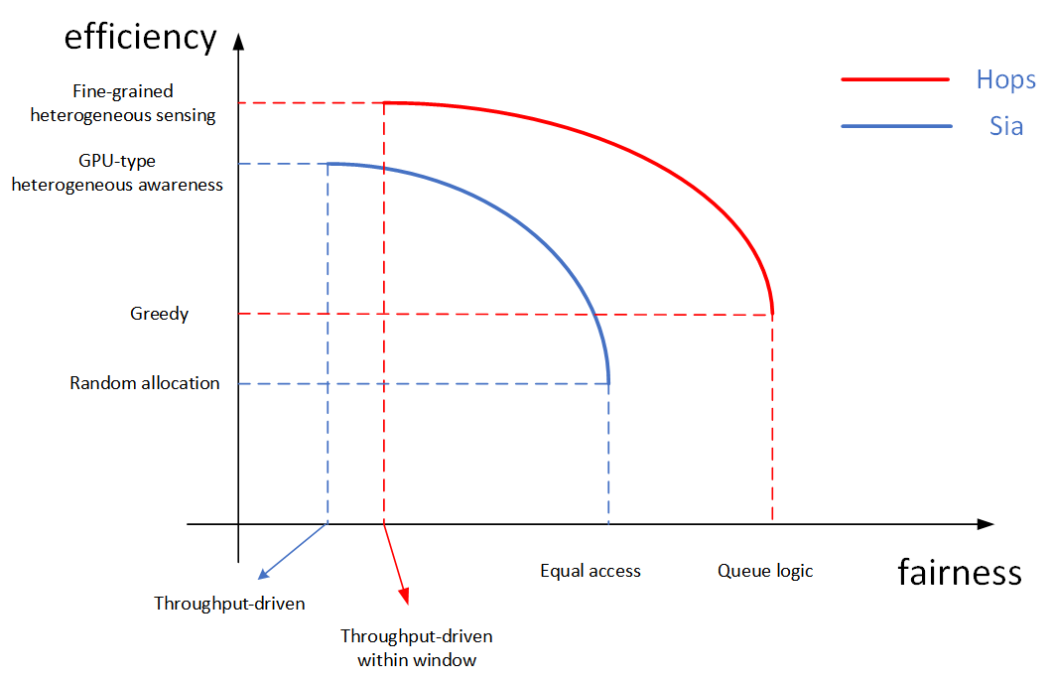





Hops: Scheduler-Prior weighted ILP formula
Objective of Hops
$$λ : 0→M$$
Objective of Sia
$$p: M→0$$
$M$ is a large number
Notes:
Here, we created a simulation graph to illustrate the efficiency-fairness curves of Hops and Sia as they adjust their hyperparameters/ˌhaɪ.pərˈpæ.rəˌmiː.tər/. Hops can adjust this balance by tuning the lambda value, while Sia relies on the p-value to balance fairness and efficiency. When maximizing efficiency, Hops can achieve higher efficiency than Sia due to its finer-grained heterogeneous sensing. At this point, Hops also maintains better fairness compared to Sia, as Sia is entirely driven by throughput-based scheduling, while Hops benefits from the service window. When both systems aim to maximize fairness, Hops fits perfectly into the queuing logic, allowing high-priority jobs to greedily select the resources with the highest throughput. Sia, on the other hand, tends to assign equal access rights to each task, which is similar to a random allocation approach. Thus, when fairness is maximized, Hops can achieve better efficiency and fairness than Sia.

Slide 22
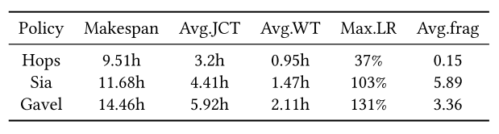
Evaluation: Physical Experiments on Cloud
Setup:
64 GPUs in 10 servers, 3 different GPU types, 2 different server types
Total of 25 tasks, and we we set a submission window of 2.5 hours
Baseline:
We compare the state-of-the-art heterogeneity-aware schedulers: Sia and Gavel
High efficiency:
reduces the makespan by approximately 18% to 34%
improves the average JCT by about 27% to 46%
Improved fairness: max latency ratio is 37%
Reduction of cluster fragments
Notes:
We conducted physical experiments in a heterogeneous real cloud platform environment and found that Hops improved performance by eighteen percent to thirty-four percent compared to SOTA heterogeneity-aware schedulers: Sia and Gavel. Hops also reduced the Average job completion time by twenty-seven percent to forty-six percent. Hops achieved better fairness metrics, the maximum latency ratio of Hops is thirty-four percent, which is lower than that of Sia and Gavel.

Slide 23
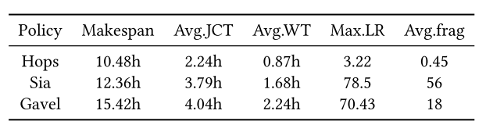
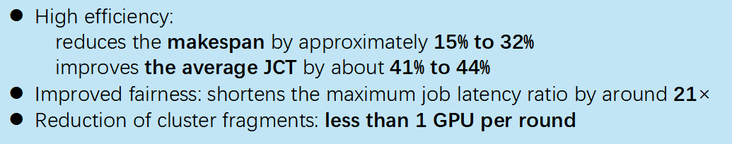
Evaluation: Physical Experiments on Cloud
Setup:
512 GPUs in 64 servers, 3 different GPU types, 3 different server types
Total of 500 tasks, and we have set a submission window of 5 hours
Baseline:
We compare the state-of-the-art heterogeneous-aware schedulers: Sia and Gavel
High efficiency:
reduces the makespan by approximately 15% to 32%
improves the average JCT by about 41% to 44%
Improved fairness: shortens the maximum job latency ratio by around 21$×$
Reduction of cluster fragments: less than 1 GPU per round
Notes:
In the simulation experiments with five hundred twelve GPUs, Hops not only shows similarly high efficiency but also reduced the maximum job latency by nearly 21 times, while decreasing cluster fragmentation to less than 1 GPU per round.

Slide 24
Thank you for listening!

